Slide 1




firewall-z
AN AI DRIVEN FIREWALL
BY,
NAMIN SRI NANDHAN P

Slide 2



INTRODUCTION
FIREWALL-Z
Firewall Z is a cutting-edge, machine learning-driven firewall solution designed to provide unparalleled security for devices by automatically updating its configuration to counter evolving threats. By harnessing the power of artificial intelligence and machine learning algorithms, Firewall Z continuously learns from network traffic patterns, malicious activity, and security intelligence feeds to optimize its rules and policies in real-time.
This innovative approach enables Firewall Z to stay ahead of emerging threats, reducing the risk of security breaches and minimizing the impact of attacks. With its ability to adapt to new and unknown threats, Firewall Z provides a robust and proactive defense mechanism, ensuring the integrity and confidentiality of device communications.
02

Slide 3


FIREWALL-Z
abstract
Develop an intelligent firewall system that utilizes machine learning algorithms to dynamically update and optimize firewall rules based on real-time network traffic and threat assessments. The system should continuously learn from incoming and historical data to autonomously adjust firewall policies, ensuring robust protection against emerging threats while minimizing false positives and maintaining network performance
03

Slide 4

FIREWALL-Z
PROBLEM STATEMENT
Develop an intelligent firewall system that utilizes machine learning algorithms todynamically update and optimize firewall rules based on real-time network traffic and threatassessments. The system should continuously learn from incoming and historical data toautonomously adjust firewall policies, ensuring robust protection against emerging threats whileminimizing false positives and maintaining network performance.
04

Slide 5
LITRETURE SURVEY
TITLE : A Machine Learning based approach for enhancing the attack detection capability of firewalls
AUTHOR : Karan Aswal, Akshay Rajmohan, Akhil Trc, S. Mukund, Vinitha Panicker, J. Dhivvya
YEAR: 2021
SUMMARY: A machine learning-based firewall, Kavach, can enhance attack detection capabilities by dynamically analyzing network traffic and updating firewall rules
TITLE : Machine Learning Based Model to Identify Firewall Decisions to Improve Cyber-Defense
AUTHOR : Q. A. Al-Haija, Abdelraouf Ishtaiwi
YEAR: 2021
SUMMARY: The paper proposes a machine learning-based model to improve firewall decisions for better cyber-defense
TITLE : SDN-based Firewall using Machine Learning
AUTHOR : G. Kiran, Koganti Sri Sai Harshith, A. M. A. Sai, Kalla Likhit Sai Eswar, L. S. Nair
YEAR: 2023
SUMMARY: An SDN-based firewall using machine learning to detect malicious packets based on header information.
05

Slide 6
LITRETURE SURVEY
TITLE :Signature-based and Machine-Learning-based Web Application Firewall
AUTHOR :Cláudio Marques, Silvestre Malta, J. Magalhães
YEAR: 2021
SUMMARY: A machine learning-based DNS firewall can accurately and quickly classify malicious domain requests
TITLE : Next Generation AI-Based Firewalls: a Comparative Study
AUTHOR : EasyChair Preprint, Sina Ahmadi
YEAR: 2021
SUMMARY: This paper provides a comparative analysis of next-generation AI-based firewalls and their effectiveness in enhancing cybersecurity.
TITLE : Research on the Application and Testing Method of AI Firewalls in Network Attack Detection
AUTHOR : Zhijia Wang, Qi Deng
YEAR: 2023
SUMMARY: AI firewalls can enhance network attack detection capabilities compared to traditional firewalls.
06

Slide 7
LITRETURE SURVEY
TITLE : A Machine Learning based approach for enhancing the attack detection capability of firewalls
AUTHOR :Karan Aswal, Akshay Rajmohan, Akhil Trc, S. Mukund, Vinitha Panicker, J. Dhivvya
YEAR: 2021
SUMMARY: Incorporating machine learning algorithms to dynamically analyze network traffic and update firewall rules can enhance the attack detection capabilities of firewalls.
TITLE : Intelligent Security: Applying Artificial Intelligence to Detect Advanced Cyber Attacks
AUTHOR : Karthik Kallepalli, Umair B. Chaudhry
YEAR: 2021
SUMMARY: Applying AI to firewalls can provide higher security by allowing adaptive behavior to detect advanced cyber attacks.
TITLE : The Emerging Threat of Ai-driven Cyber Attacks
AUTHOR : Guembe Blessing, A. Azeta, Sanjay Misra, V. Osamor, L. F. Sanz, Vera Pospelova
YEAR: 2022
SUMMARY: Existing cybersecurity defenses will be inadequate against the increasing speed and complexity of AI-driven cyberattacks
07

Slide 8

FIREWALL-Z
PROJECT OBJECTIVE
he objective of the Firewall-Z project is to develop an AI-driven firewall system capable of proactively detecting, analyzing, and mitigating cybersecurity threats in real time. By leveraging machine learning models, Firewall-Z aims to enhance traditional firewall capabilities, offering adaptive security that anticipates vulnerabilities and takes automated actions to protect network integrity. This solution seeks to provide high accuracy in threat detection, minimize false positives, and operate with low latency and efficient resource usage, making it scalable and suitable for various network environments. The ultimate goal is to create a robust, marketable firewall solution that meets modern cybersecurity demands in a dynamic threat landscape.
08

Slide 9


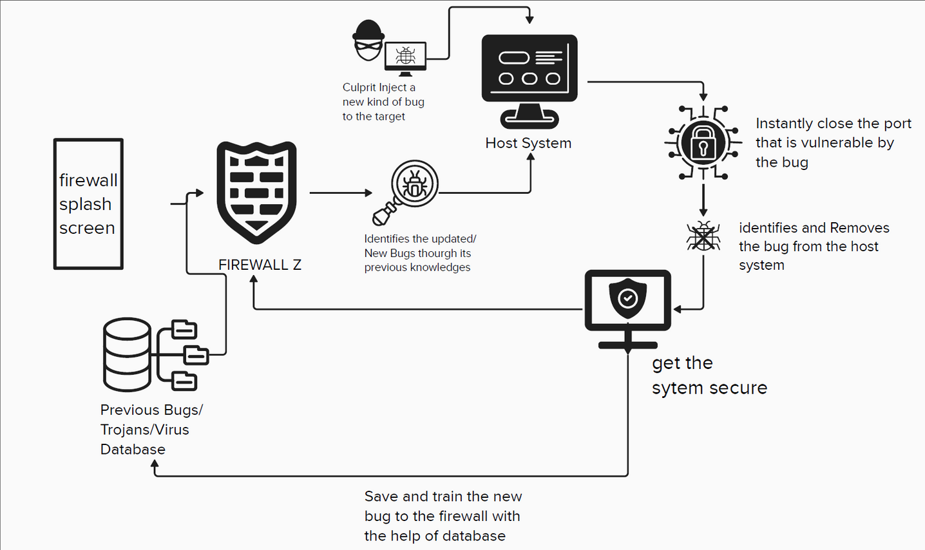
ARCHITECTURE DIAGRAM
FIREWALL-Z
09

Slide 10


TECHNOLOGIES REQUIREMENTS
•FRONTEND- HTML, CSS, JAVASCRIPT
•BACKEND- Python
•CLOUD- IBM Cloud
•ALGORITHM USED- SVM
10

Slide 11

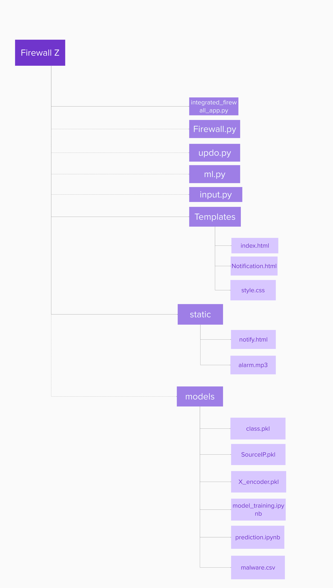
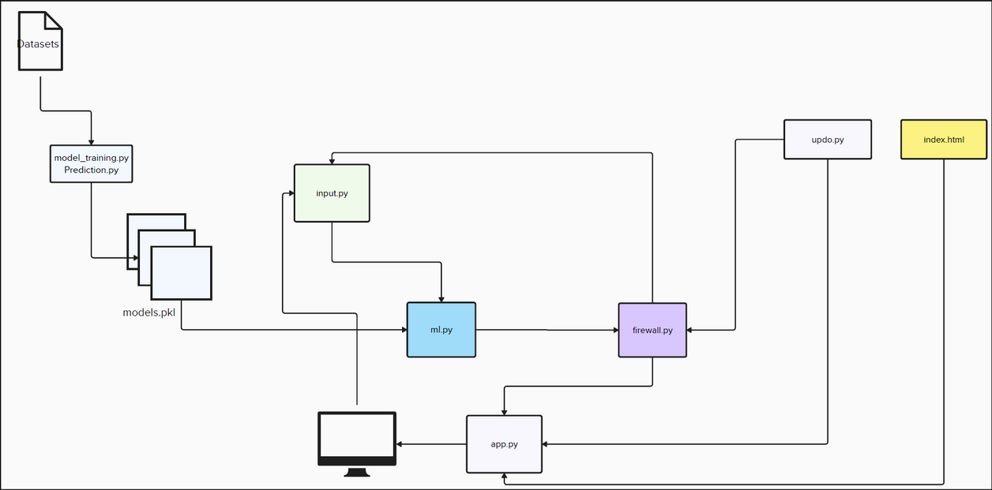
MODULES SPLITUP
11

Slide 12
references
Fathia, Ademola. "Machine Learning Algorithms for Anomaly Detection in Next-Gen AI-Based Firewalls: A Performance Analysis." (2024).
Musa, Martha Ozohu, and Temitope Victor-Ime. "Improving Internet Firewall Using Machine Learning Techniques." American Journal of Computer Science and Technology 6, no. 4 (2023): 170-179.
Ahmadi, Sina. "Next Generation AI-Based Firewalls: A Comparative Study." International Journal of Computer (IJC) 49, no. 1 (2023): 245-262.
Choudhury, Madhab Paul, and J. Paul Choudhury. "Machine Learning Based Model to Find Out Firewall Decisions Towards Improving Cyber Defence." In International Conference on Internet of Things and Connected Technologies, pp. 179-195. Singapore: Springer Nature Singapore, 2022.
Al-Haijaa, Qasem Abu, and Abdelraouf Ishtaiwia. "Machine learning based model to identify firewall decisions to improve cyber-defense." International Journal on Advanced Science, Engineering and Information Technology 11, no. 4 (2021): 1688-1695.
Applebaum, Simon, Tarek Gaber, and Ali Ahmed. "Signature-based and machine-learning-based web application firewalls: a short survey." Procedia Computer Science 189 (2021): 359-367.
AL-Behadili, Hayder Naser Khraibet. "Decision tree for multiclass classification of firewall access." International Journal of Intelligent Engineering and Systems 14, no. 3 (2021): 294-302.
Zhao, Quanling, Jiawei Sun, Hongjia Ren, and Guodong Sun. "Machine-learning based TCP security action prediction." In 2020 5th International Conference on Mechanical, Control and Computer Engineering (ICMCCE), pp. 1329-1333. IEEE, 2020.
Naseer, Iqra. "Implementation of Hybrid Mesh firewall and its future impacts on Enhancement of cyber security." MZ Computing Journal 1, no. 2 (2020).
Dawadi, Babu R., Bibek Adhikari, and Devesh Kumar Srivastava. "Deep learning technique-enabled web application firewall for the detection of web attacks." Sensors 23, no. 4 (2023): 2073.
El Kamel, Nadiya, Mohamed Eddabbah, Youssef Lmoumen, and Raja Touahni. "A smart agent design for cyber security based on honeypot and machine learning." Security and Communication Networks 2020, no. 1 (2020): 8865474.

